Slide 1

The use of social media by entrepreneurial and small firms: a systematic literature review

Slide 2

The use of social media by entrepreneurial and small firms: a systematic literature review
Pantas H. Silaban
University of HKBP Nommensen
Indonesia
Wen-Kuo Chen
Chaoyang University of Technology
Taiwan
Andri Dayarana K. Silalahi
Chaoyang University of Technology
Taiwan
1
2
3

Slide 3
The use of social media by entrepreneurial and small firms: a systematic literature review
Table of Content
01
Introduction
Table of
Contents
02
Methodology
03
Results and Discussion
04
Conclusion

Slide 4
Introduction

Slide 5

The significance of social media today !
Interaction, Communication, Entertainment
Shoppertainment
Customer Engagement
Selling

Slide 6
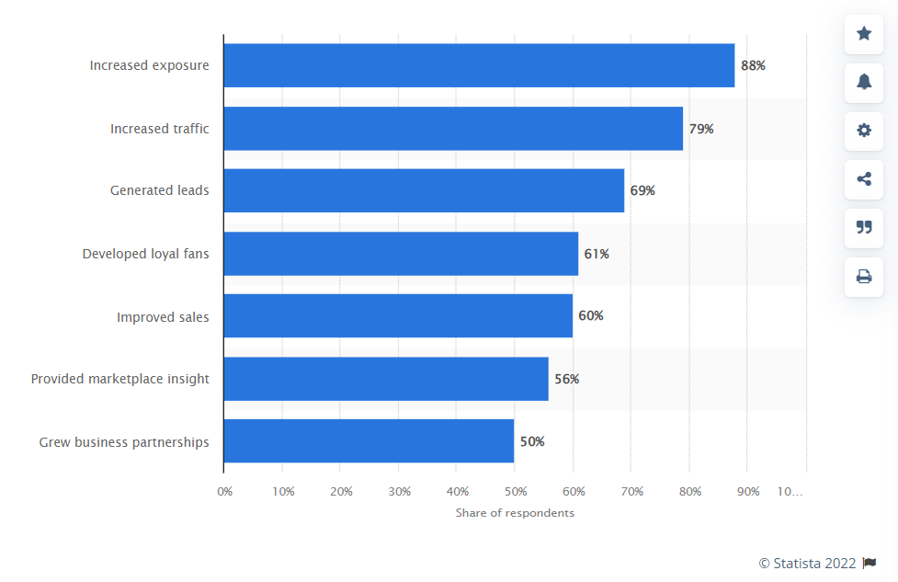
Why Social Media ?

Slide 7
How entrepreneurs and small firms leverage social media
Marketing Channel
Customer
Conducting marketing activities, brand awareness, strategy.
Reach a wider customer, directly interact with customers.
02
03
01
04
Sales
Exposure
To increase sales through social media features.
Brand and product exposure to increase awareness.

Slide 8
Research Motivation and Purpose
Model
Future Research
To find out the model of leveraging social media
for entrepreneurs and small firms.
Provide future research direction regarding how entrepreneurs and small firms leveraging social media for the business.
Factors
Guideline
To provide insight for entrepreneurs and small firms how effective social media for business nowadays.
To find out what influencial factors that affecting effectiveness of social media for entrepreneurs and small firms.

Slide 9
Methodology

Slide 10
Search Strategy
Step 1
Step 02
Step 03
Step 04
Step 05
Data Base
Preliminary Search
Inclusion, year 2016 – 2022
Inclusion, Open Access
Results
Scopus
Total n=148 Articles
Inclusion criteria 1 (n=88)
Inclusion criteria 2 (n=24)
Results for Review (n=23)

Slide 11
Results and Discussion

Slide 12
Paper list based on Quartile
12
1
Quartile 1
Quartile 3
7
2
Quartile 2
Quartile 4
1
Others

Slide 13
Paper list based on Geographical
Paper based on Geographical
Vietnam 1
Czech Republic 1
Malaysia 1
Zambia 1
China 1
Finland 1
Canada 1
Sweden 2
USA 1
Austria 1
Italy 3
Germany 1
UK 3
Africa 1
Spain 1

Slide 14
Methodological Based Cluster
01
Qualitative
Interview (managers, business owners)
03
Literature
Bibliomatric, systematic literature review,
02
Quantitative
Survey (entrepreneurs, managers, employee)

Slide 15
Social Media Strategy Infographics
Market
e-Commerce
(Social Commerce)
Internationalization
National &
International
SM Market
Small-Firms
Entrepreneurs
Self-Efficacy, Innovativeness, Dedication, Motivation (accomplishment), Leadership.
Entrepreneur Orientation, Market Orientation, Innovation Orientation, Resource Leveraging. Management Effectiveness.
National (Local, Domestic)
Competitive Advantage
Customer
Market
Social Media Users
Personalization
National & International
Information

Slide 16
Future Research Opportunity
Social Media (ENT & SMF)
1
Collaborative strategies on social media to the broad market.
Psychological and cognitive approach to examine entrepreneurs’ experience throughout dynamic experiential learning.
4
2
World wide customer through e-commerce and m-commerce integrated to the use of social media.
The difference between EO in nations and sub-nations as culture are not always similar.
5
3
Exploring the resource availability on social media.
Using the fsQCA analysis technique to generate decision based implication and robust the theoretical implication.
6

Slide 17
Conclusion and Limitation

Slide 18
There are several conclusion might reach through the study.
Social media usage is about utilizing technology tools to extend the market, establish a competitive advantage, and attract new clients to the brand (market).
Entrepreneurs and small businesses can categorize their social media research methods into two broad categories: quantitative and qualitative.
The most widely used approaches in the published research were structural equation modeling, fuzzy set quantitative comparison analysis, explanatory factor analysis, and correlation analysis.
Entrepreneurs may use social media to their advantage by having a high level of self-efficacy.

Slide 19
Limitation
Single Database source (Scopus)
Future Research
Multiple source database
Generate possible future research model

Slide 20

Thank You !!

